Slide 1
CSE291 – Introduction to Software Engineering (FALL 2022)
Entity Relationship Diagram

Slide 2
Entity Relationship Diagram
ERD is a data modeling technique used in software engineering to produce a conceptual data model of an information system.
Illustrate the logical structure of database.
It describe how these data are related to each other.
For example, the entities writer, novel, and consumer may be described using ER diagrams this way:

Slide 3
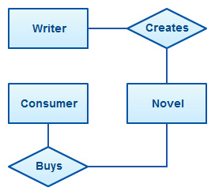
Entity Relationship Diagram

Slide 4
Entity Relationship Diagram
E/R Modelling is used for conceptual design
Entities - objects or items of interest
Attributes - Properties of an entity
Relationships -links between entities
Example
In a University database we might have entities
- Students
- Courses
- Lecturers
Students might have attributes such as their ID , Name and Phone number, and could have relationships with Courses and Lecturers.

Slide 5
Entity Relationship Diagrams
E/R Models are often represented as E/R diagrams
Lecturer
ID
Name
Ph#
teaches
Student
Course
Register

Slide 6
Entities
Entities represent objects or things of interest
Physical things like students, lecturers, employees..
More abstract things like modules, orders, courses, projects
Entities have
A general type or class, such as Lecturer or Module
Instances of that particular type, such as Steve Mills, Natasha are instances of Lecturer
Attributes (such as name, email address)

Slide 7
Entities
In an E/R Diagram, an entity is usually drawn as a box with rounded corners or Rectangle
The box is labelled with the name of that entity
Lecturer
ID
Name
PH#
teaches
Student
course
Register

Slide 8
Attributes
Attributes are properties, or details about an entity
Students have IDs, names, addresses, …
Courses have codes, titles, credit hours. .…

Slide 9
Diagramming Attributes
In an E/R Diagram attributes may be drawn as ovals
Each attribute is linked to its entity by a line
The name of the attribute is written in the oval
Lecturer
ID
Name
Ph#
Teaches
Student
Course
Register

Slide 10
Types of Attributes
Composite Attributes
Multivalued Attributes
Derived Attributes

Slide 11
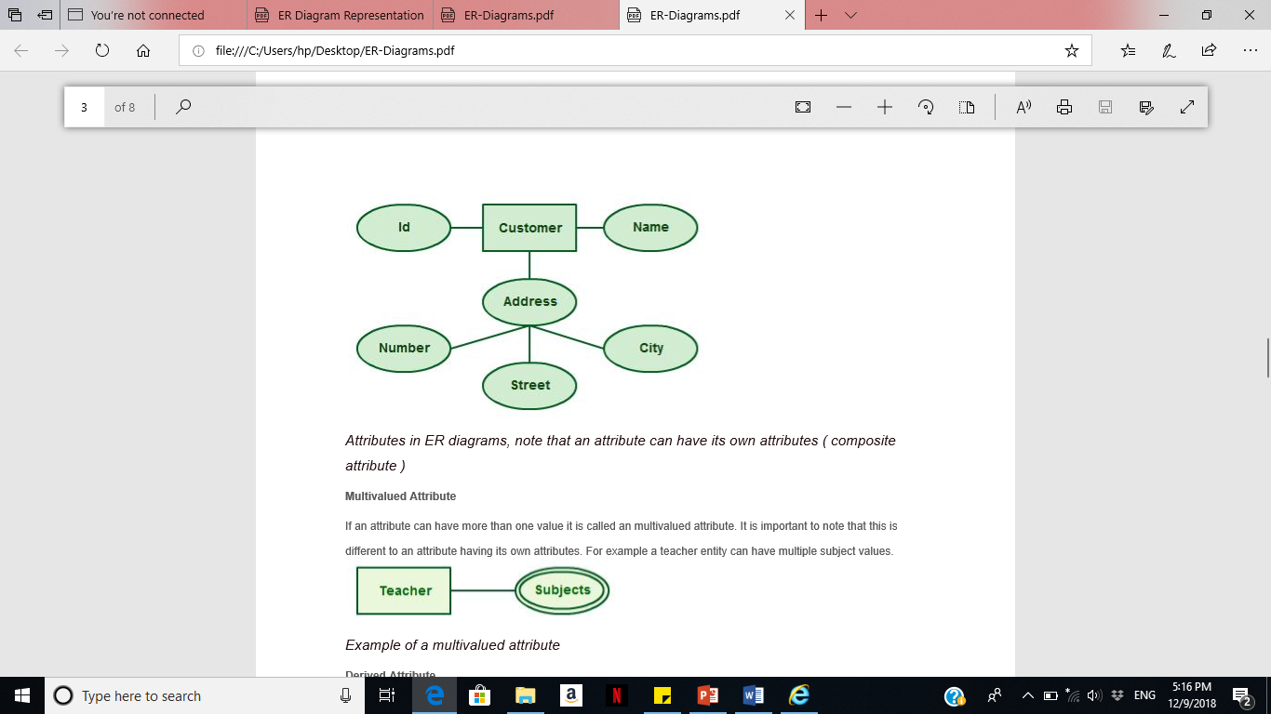
Types of Attributes
Composite attributes
Attributes can also have their own specific attributes. For example, the attribute “customer address” can have the attributes “number, street, city, and state”.

Slide 12
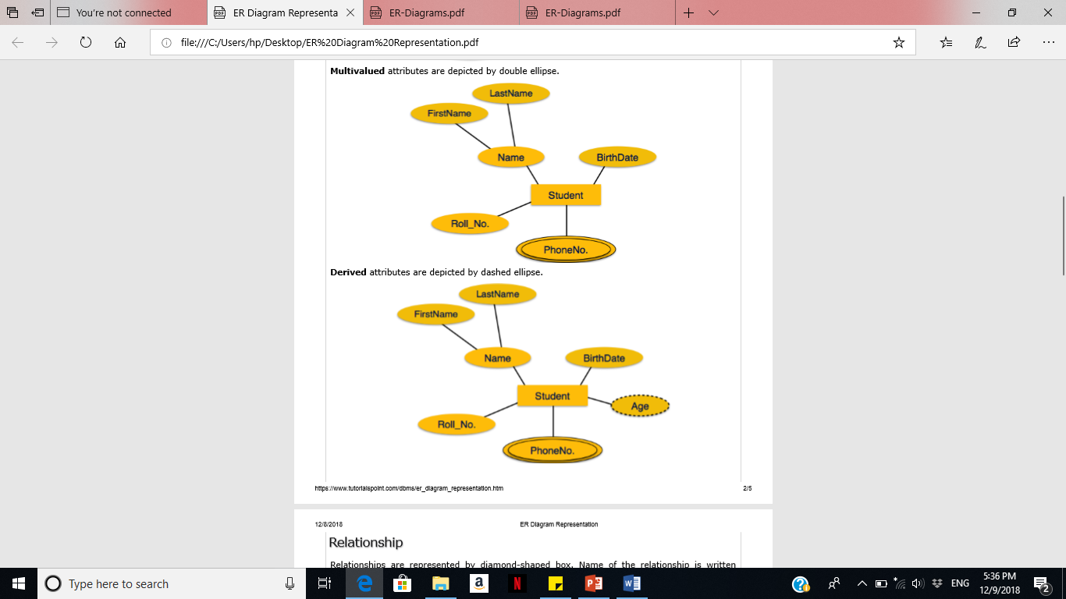
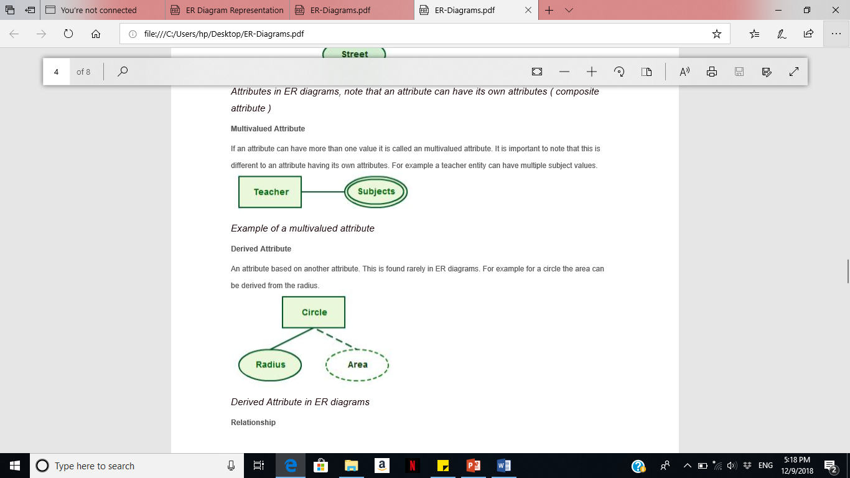
Types of Attributes
Multivalued Attribute
If an attribute can have more than one value it is called an multivalued attribute.
For example a teacher entity can have multiple subject values.

Slide 13
Types of Attributes
Derived Attribute
An attribute based on another attribute. This is found rarely in ER diagrams. For example for a circle the area can be derived from the radius.

Slide 14
Relationships
Relationships are an association between two or more entities
Each Student takes several Courses
Each Course is taught by a Lecturer
Each Employee works for a single Department
Relationships have
A name
A set of entities that participate in them
A degree - the number of entities that participate (most have degree 2)
A cardinality ratio

Slide 15
Cardinality Ratios
Each entity in a relationship can participate in zero, one, or more than one instances of that relationship
This leads to 3 types of relationship…
One to one (1:1)
Each lecturer has a unique office
One to many (1:M)
A lecturer may teaches many students, but each student has just one tutor for specific course
Many to many (M:M)
Each student takes several courses and each course is taken by several students

Slide 16
Diagramming Relationships
Relationships are links between two entities
The name is given in a diamond box
The ends of the link show cardinality
Lecturer
ID
Name
Ph#
Teaches
Student
Course
Register
One
Many

Slide 17
Making E/R Models
To make an E/R model you need to identify
Entities
Attributes
Relationships
Cardinality ratios
from a description
General guidelines
Since entities are things or objects they are often nouns in the description
Attributes are properties, and often nouns
Verbs often describe relationships between entities

Slide 18
Exercise 1
We want to represent information about products in a database.
Each product has a Product id, description, and price. Supplier supply the products.
Supplier have address, phone numbers, and name. Each address is made up of a street address, a city, and a postcode.

Slide 19
Exercise 2
Draw an Entity Relationship Model that captures this information about the UPS (united parcel service) system.
UPS prides itself on having up-to-date information on the processing and current location of each shipped item. To do this, UPS relies on a company-wide information system.
Shipped items are the heart of the UPS product tracking information system. Item number, weight, dimensions, insurance amount, destination, and final delivery date can identify shipped items. Shipped items are received into the UPS system at a single retail center. Their type, unique ID, and address identify retail centers. Shipped items make their way to their destination via one or more standard UPS transportation events.
These transportation events are characterized by a unique schedule Number, a type (e.g., flight, truck), and a delivery Route.

